Slide 1
2020-21 Budget Workshop
June 22, 2020

Slide 2
Wrapping up 2019-20
PVS
Revenue | Revised Budget $1.04/$1.17/$1.0684 | 2019-20 Estimated Finish - $1.0684
Local | 55,320,475 | 55,320,596
State | 63,368,591 | 61,368,170
Federal | 1,545,000 | 875,437
Total | 120,234,066 | 117,564,203
Expenses | Revised Budget $1.04/$1.17/$1.0684 | 2019-20 Estimated Finish - $1.0684
Payroll | 88,065,197 | 86,985,000
Contracted Services | 12,557,305 | 12,124,190
Supplies | 4,082,011 | 4,127,190
Misc. Operating | 2,209,055 | 1,713,458
Debt Service | 112,408 | 112,322
Capital Outlay | 138,485 | 773,109
Total | 107,164,462 | 105,835,118
Remaining | 13,069,604 | 11,835,118

Slide 3
Fund Balance Summary – General Fund
 | General Fund
Beginning Fund Balance | 28,167,925
2019-20 Total Excess | 11,729,085
Scoreboard Capital Lease | 545,148
Transfer Out to Food Service | (500,000)
Predicted Transfer Out (.13 pennies) | (6,555,788)
General Fund Excess | 5,218,445
Estimated Fund Balance as of June 30, 2020 | 33,386,370

Slide 4
Revenue Factors

Slide 5
2020-21 Revenue Factors
Local
April 2019 Preliminary Taxable Value - $4,897,531,746
Johnson County - $3,133,380,479
Tarrant County - $1,764,151,267
July 2019 Certified Taxable Value - $5,080,405,853
Johnson County - $3,256,496,510
Tarrant County - $1,823,909,343
April 2020 Preliminary Taxable Value - $5,416,773,693
Johnson County - $3,466,040,476
Tarrant County - $1,950,733,217
State
ADA Formula: 2018-19 average of first 4 six weeks/6th six weeks = ratio applied to 2019-20 first four six weeks. Burleson ISD is 11,891.82, plus 100 for enrollment.
Demographer Report
3.3% - Pre-COVID
1% - After COVID
Summary of Finance – CCMR, ADA, and Special Education
Federal
SHARS questionable

Slide 6
Expenditure Factors

Slide 7
Budget Considerations - Salaries
Teachers
Beginning pay increased to $55,500
$1,000 increase for approx. 747 teachers - $747,000
Non-Teacher Employee Groups*
2% of Midpoint - $1,167,329
Personnel – Non Payroll (Contracted Services)
SRO Officer for REALM - $118,000 (includes one time fixed cost for vehicle)
New Hire Considerations
4 Teachers (CHS)
3 Teachers (BHS, KMS, HMS)
2 Counselors (BHS, CHS)
4 Dyslexia (HS, HMS/STEAM, KMS/REALM, Districtwide)
Special Education: .5 LSSP, 2 Behavior Specialists, 2 SLP assts., Diags
Nurse
*Includes new hiring schedule for paraprofessionals and auxiliary.

Slide 8
Teacher Matrix
Notes:
2.5% midpoint last year was $617,876, 3% was $734,521

Slide 9
UEA
Notes:
2.5% midpoint last year was $617,876, 3% was $734,521

Slide 10
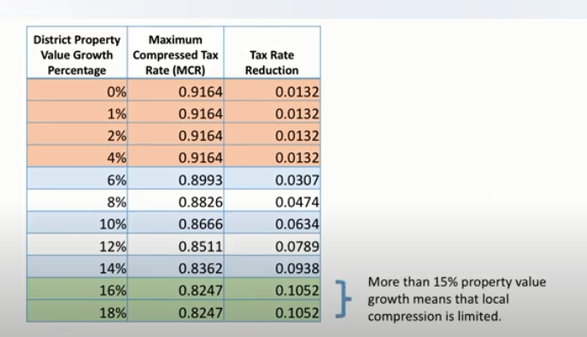
Value Growth and Tier One Tax Rates

Slide 11
General Fund – 2020-21 Projected
Revenue | 2019-20 Original Budget | 2019-20 Estimated Finish | 2020-21 Projected - $1.0547 | 2020-21 Projected - $1.0376
Local | 55,320,475 | 55,320,596 | 58,343,098 | 57,076,717
State | 63,368,591 | 61,368,170 | 60,831,456 | 60,711,456
Federal | 1,545,000 | 875,437 | 1,620,000 | 1,620,000
Total | 120,234,066 | 117,564,203 | 120,794,554 | 119,408,173
Expenses | 2019-20 Original Budget | 2019-20 Estimated Finish | 2020-21 Projected - $1.0547 | 2020-21 Projected - $1.0376
Payroll | 88,065,197 | 86,985,000 | 91,557,099 | 91,557,099
Contracted Services | 12,557,305 | 12,124,190 | 12,980,517 | 12,980,517
Supplies | 4,082,011 | 4,127,038 | 4,261,595 | 4,261,595
Misc. Operating | 2,209,055 | 1,713,458 | 2,235,446 | 2,235,446
Debt Service | 112,408 | 112,322 | 112,408 | 112,408
Capital Outlay | 138,485 | 773,109 | 98,149 | 98,149
Total | 107,164,462 | 105,835,118 | 111,245,211 | 111,245,211

Slide 12
2020-21 Fund Balance Projection
Funding Sources
9,549,343 | Projected budget excess
(1,386,831) | Tax rate reduction
(1,000,000) | CCMR, SHARS, gate receipts, interest, enrollment, NIFA
(6,900,000) | Transfer out
265,512 | Excess to Fund balance

Slide 13
Debt Service
Revenue | 2019-20 Original Budget | 2019-20 Estimated Finish | 2020-21 Projected
Local | 24,087,659 | 25,237,659 | 27,122,191
State | 479,437 | 647,111 | 0
Transfer in | 0 | 3,200,000 | 0
Total | 24,567,096 | 29,084,770 | 27,122,191
Expenses | 2019-20 Original Budget | 2019-20 Estimated Finish | 2020-21 Projected
Debt Service | 29,229,558 | 29,472,816 | 23,163,198
Total | 29,229,558 | 29,472,816 | 23,163,198

Slide 14
Food Service
Revenue | 2019-20 Original Budget | 2019-20 Estimated Finish | 2020-21 Projected
Local | 3,154,481 | 2,385,410 | 3,025,000
State | 120,000 | 170,550 | 180,000
Federal | 3,338,206 | 2,970,150 | 3,500,000
Total | 6,612,687 | 5,526,111 | 6,705,000
Expenses | 2019-20 Original Budget | 2019-20 Estimated Finish | 2020-21 Projected
Food Service (35) | 6,426,358 | 3,240,381 | 6,616,286
Operations (51) | 35,000 | 28,000 | 35,000
Total | 6,461,358 | 6,268,381 | 6,651,286
Revenue based on meal increase of $0.10 at secondary and $0.05 at elementary.

Slide 15
Required Line Items
Accelerated Education
Legal Postings
Advocacy Expenditures
Property Lag Slide FIRST 20
2018-19 July Certified $4,545,915,174
2019-20 July Certified $5,080,405,853
Using current property values incorporates the increase in the state funding template resulting in lower state aid.

Slide 16
Proposed Budget – General Fund

Slide 17
Proposed Budget – Debt Service

Slide 18
Proposed Budget – Food Service

Slide 19
Budget Amendments – General Fund

Slide 20
Budget Amendments – Debt Service

Slide 21
Budget Amendments – Food Service

